Slide 1
Cross-border public procurement in practice: Ukrainian companies in GPA markets
Oleksandr Shatkovskyi, Public Procurement Consultant, GPAinUA (2019-2020)
Geneva, March 19, 2024
EBRD GPA TC Facility

Slide 2
GPAinUA project – 2019-2020
- Facilitation and FREE support for Ukrainian business to try themselves in GPA tenders
- Improvement of competitive skills of Ukrainian business
- Removal of barriers in tenders between GPA members
- Providing advices for the Government on protection of interests of Ukrainian business in context of GPA-related communications including acceding countries and observers

Slide 3
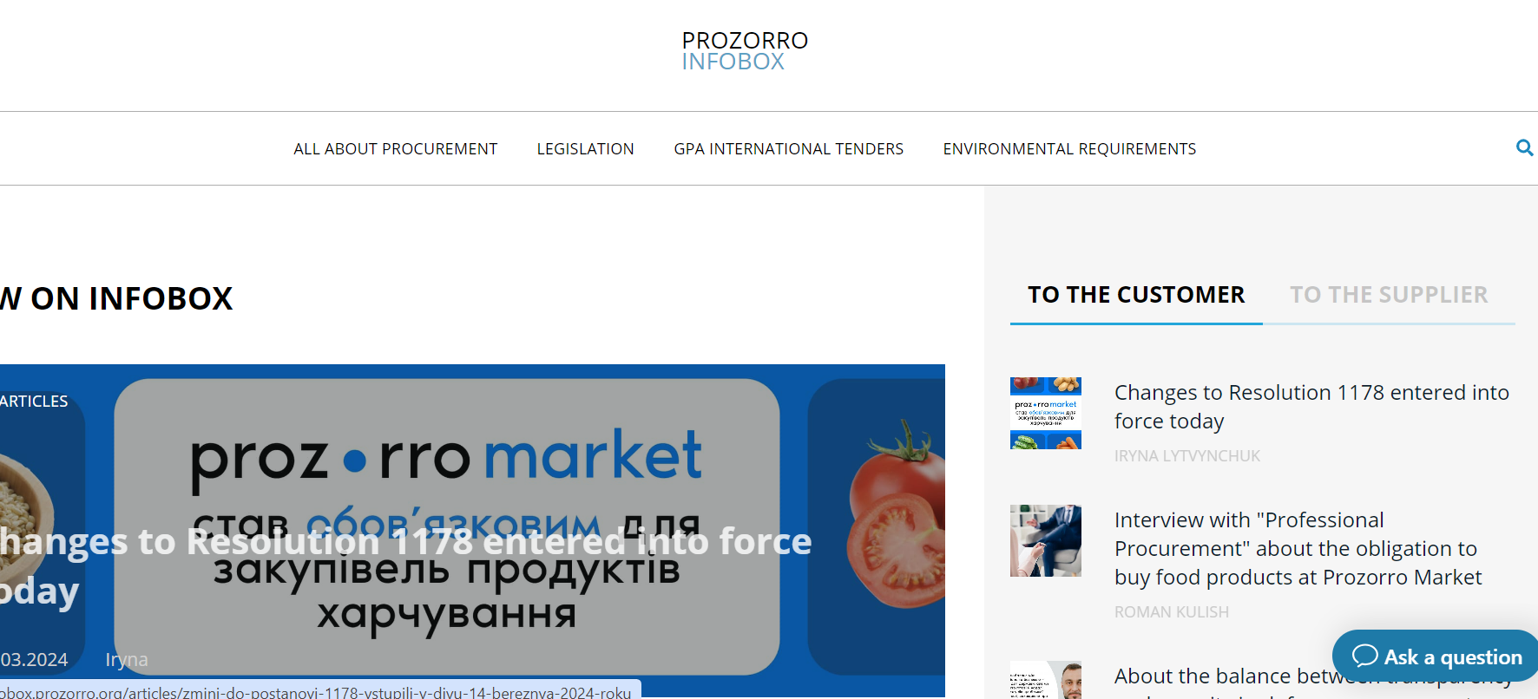
GPAinUA platfrom
https://infobox.prozorro.org/gpa
Click to go to GPA tenders
3
3

Slide 4
GPAinUA platfrom
https://infobox.prozorro.org/gpa
G
With the support of the EBRD and within the framework of the GPAinUA Project since November 2020,the special section (platform) "GPA International Tenders" (https://infobox.prozorro.org/gpa ) has been created on the Information Resource on Public Procurement INFOBOX.PROZORRO, designed to provide practical assistance to domestic businesses to participate and win in public procurement outside Ukraine, primarily in the GPA member countries. The platform contains:
-- overview of the GPA Procurement Agreement as a source and mechanism of new export opportunities for Ukrainian business; -- a list of national procurement platforms with procurement info and announcements from GPA countries; -- detailed guidelines and recommendation on how to participate in tenders in individual countries of the Agreement (for example, the Baltic States, Poland, Italy, the Czech Republic, etc.); -- Results of the survey (2020) of Ukrainian business on the interest in participating in procurement of the countries of the Agreement on Government Procurement.

Slide 5
Results of the survey (2020) of UA business on the interest in participating in tenders abroad
141 answers were received from 1000 companies out of 8000 as addressees for the specifically shared questionnaire.
The following elements of the procurement process are seen as the most important for UA respondents to consider when participating in tenders abroad:
Which technical standards/requirements are applied and what is the local mechanism for proving conformity of own products with local standards?
Electronic accessibility to tender notices (in electronic form) and to e-submissions.
Peculiarities regarding payment conditions of local public contracts.
The most important needs to for encouraging participation of Ukrainian EOs in public tenders outside of Ukraine:
Establishment of permanent information points for providing regular information about announced tenders in the respective countries (all 141 respondents);
Improvement of technical standardization system to provide recognition of Ukrainian products as complaint with international standards (138 respondents);
Accessibility of bank services for export operations incl. loans, factoring (136 respondents),
Support for searching of local partner/subcontractor in foreign countries for the purpose of participation in local tenders there (128 respondents);
Simplification/improvement of Ukrainian legislation regarding custom procedures for export operations, taxation of export operations, foreign currency circulation regulations (130 respondents).
In many foreign countries information about the procurement process is not such accessible for free like in Ukraine.

Slide 6
Recommendations based Results of the survey
Establishment of special permanent foreign tenders support facility (service) to perform the following and other activities identified along the way:
Assistance with formalities on tender securities and with identifying tender opportunities, legal consultations;
Assistance with search for foreign partners as well as in selection of partners for consortia or subcontracting,
Help in harmonization of technical standards to approximate Ukrainian products to foreign standards, informational support and special consulting support on technical certification,
Permanent forum for exchange of experiences of Ukrainian business trying to participate in foreign tenders,
Improvement of technical standardization system to provide recognition of Ukrainian products as complaint with international or local standards or technical regulations.
Improvement of accessibility of financial services for export operations incl. loans, factoring, tender and contract securities, insurances – in particular through strengthening of activities of the Export Credit Agency established in 2018 but still not very visible in the market.
Simplification/improvement of Ukrainian legislation regarding custom procedures for export operations, taxation of export operations, foreign currency circulation regulations.
Organization of specific training for EOs as well as development of the special separate online courses..

Slide 7
Economic sectors where Ukrainian companies have been successfully participating in tenders abroad –
in GPA countries (including with the support of the GPAinUA project)
Machine-building IT (software development primarily) & Telecommunications Light industry Furniture Polygraphy Architectural and Engineering Construction Services Construction materials Vehicles and structures

Slide 8
Case of successes
CZECH REPUBLIC (2020-2021)
Buyer: municipal transport company of town of Jihlava Contract: Supply of Trolleybuses (CPV: 34622300) Value: 82 740 000.00 CZK (or 2 646 690 EURO) Type of procedure: Open tender
Awarded Tenderer: Consortium: “TRAM for ENVI s.r.o.” (CZ) and “Bogdan Motors” (UA)
Ireland (2020-2021)
Buyer: municipal Health Service of town of Naas (County Kildare) Contract: Supply of beddings and towels (lots within CPV: 3951****) Type of procedure: Dynamic Purchasing System
Awarded Tenderer: Vash Textile LLC (https://shopvashtextil.com.ua/en/page/show/about )

Slide 9
Available tender opportunities in Ukraine: well related to Recovery of Ukraine
Classical Public Procurement opportunities – tendered via PROZORRO
Projects funded by international donors and creditors – tendered via PROZORRO
Projects funded by international donors and creditors – tendered via international resources
Contracts of private/corporate sector -- tendered via own resources and via certain platforms accredited in PROZORRO

Slide 10
Business perception of PROZORRO (https://prozorro.gov.ua/en)
According to the results of the several surveys in 2018-2022, businesses fully shared the opinion of contracting authorities and civil society that the main feature of the electronic system PROZORRO was the maximum openness of PP information.
-- At the same time, the biggest advantage of the system for business was convenience of online documentary formalities related to participation in procurement procedures.
254 вidders from 46 countries in 2022 participated in Ukrainian Public tenders (generally, economic operators of 68 foreign countries are registered in PROZORRO as for end of 2022). In terms of contract values, the most successful bidders in 2022 were from POLAND (>57 mln EURO), SWITZERLAND (46,6 mln EURO) and from FRANCE (45 mln EURO).

Slide 11
Latest facts (as of end of January 2024)*
~ 58020 Buyers (incl. units within one entity as well as 4 CPB at central level and 6 regional CPBs)
>20 mln.
contracts since 2016
~ 4% savings
(~ 8 bln. EURO)
Calculated as difference between initial estimated value and awarded value
2.9
Average number of non-disqualified bidders (in 2020),
2,21 (as for 2023)
>200 bln. EURO – value of contracts covered by PROZORRO from 2016
*www.bi.prozorro.org
549 800 bidders
(were registered since 2016, more than 270 000 are active now)

Slide 12
Procurement procedures (generally and during Martial Law/ML)
PROCEDURES | USUAL LIFE | MARTIAL LAW
Open Tender | V | V
Restricted Tender | V | X
Competitive Dialogue | V | X
Negotiated Procedure | V | X
Framework Agreements | V | V
E-shop | V | V
Direct award (low value contracts and exemptions) | V | V

Slide 13
Practical aspects of procurement process
Procurement Objects -- on the basis of EU CPV codes.
There are NO LIMITATIONS FOR FOREIGN companies to be registered in PROZORRO (except for those under sanctions from Russia, Belarus, Iran)
Publication
Up to 17! different documents and notices on each procurement process (incl. contracts and contract amendments) are published in PROZORRO.
Popularity of E-shop PROZORRO.MARKET
TWO E-catalogues (medical goods&equipment and common use commodities (fuels, stationery, furniture, vehicles etc) in special E-shop service (https://prozorro.gov.ua/ProzorroMarket )
Domination of lowest price criteria and rare use of multi-criteria
It is possible to use multi-criteria (MEAT) but in case of open tender lowest price can NOT be less than 70% of total weight.
E-auction -- is not mandatory now BUT still is preferrable evaluation method.

Slide 14
Procurement for Recovery: incredible transparency
DREAM -- Digital Recovery EcoSystem for Accountable Management (https://dream.gov.ua/ ) is a state digital ecosystem that provides a single digital pipeline for all reconstruction projects.
DREAM collects, organizes and publishes open data across all stages of reconstruction projects in real time, implementing the highest standards of transparency, and accountability.
Communities can create projects, present them to international partners to attract financial resources and manage the construction process
Anyone, anywhere, can monitor the effectiveness and efficiency of projects performances, and use these insights to mitigate risks, conduct accurate reporting and improve overall project performance.
Some important descriptive details are available here: https://docs.google.com/presentation/d/1zl5a9W53GSwJcRKvYjujYLHmv548rLbY/edit?fbclid=IwAR3RmIjQz8ehYrlYYeHlbJceh0SPvfsHZSwlRu5vNv0hHAaZFICa0TwkOCU#slide=id.p1

Slide 15
Contracts of IFIs in Ukraine – tendered via PROZORRO
Possible if donor/creditor specifically endorses such possibility.
Applied for contracts below certain “international” thresholds (for example, appr. 5 mln. EUR for works or 100 000-200 000 EUR for goods).
Being based on national framework still includes important element of donor’s/creditor’s procurement rules (for example, Covenant of Integrity, specific previous contracts experience, specific contract conditions, additional grounds for bids rejections etc).
Special procedural constructor for IFIs projects became available in PROZORRO since September 2023. World Bank and some US-funded projects have already used this tool for national bidding.

Slide 16
Concluding observations and recommendations
Direct participation in tenders abroad is relatively rare, even in the EU -- so establishing partnership with local companies or subcontraсting them -- is very efficient and rational approach to minimize obvious barriers:
Local language of documents and communications as well as local speficic regulations;
Procedural deviations, possible complications related to digital communications/digital signatures.
Ukrainian resources which may help to find local partner in Ukraine:
Entrepreneurship and Export Promotion Office (business.diia.gov.ua/en/eepo) – consulting, partners search, exhibitions
Online business cooperation platform of the Ministry of Foreign Affairs and diplomatic missions NAZOVNI (https://nazovni.online/en/import-application )
The Ukrainian Chamber of Commerce and Industry (https://ucci.org.ua/en/about) -- consulting, partners search, exhibitions
Europen business association (https://eba.com.ua/en/) -- This initiative was initially supported by the European Commission and has grown to become one of the largest and most influential business communities in the country.

Slide 17
Thank you for the attention!

