Slide 1
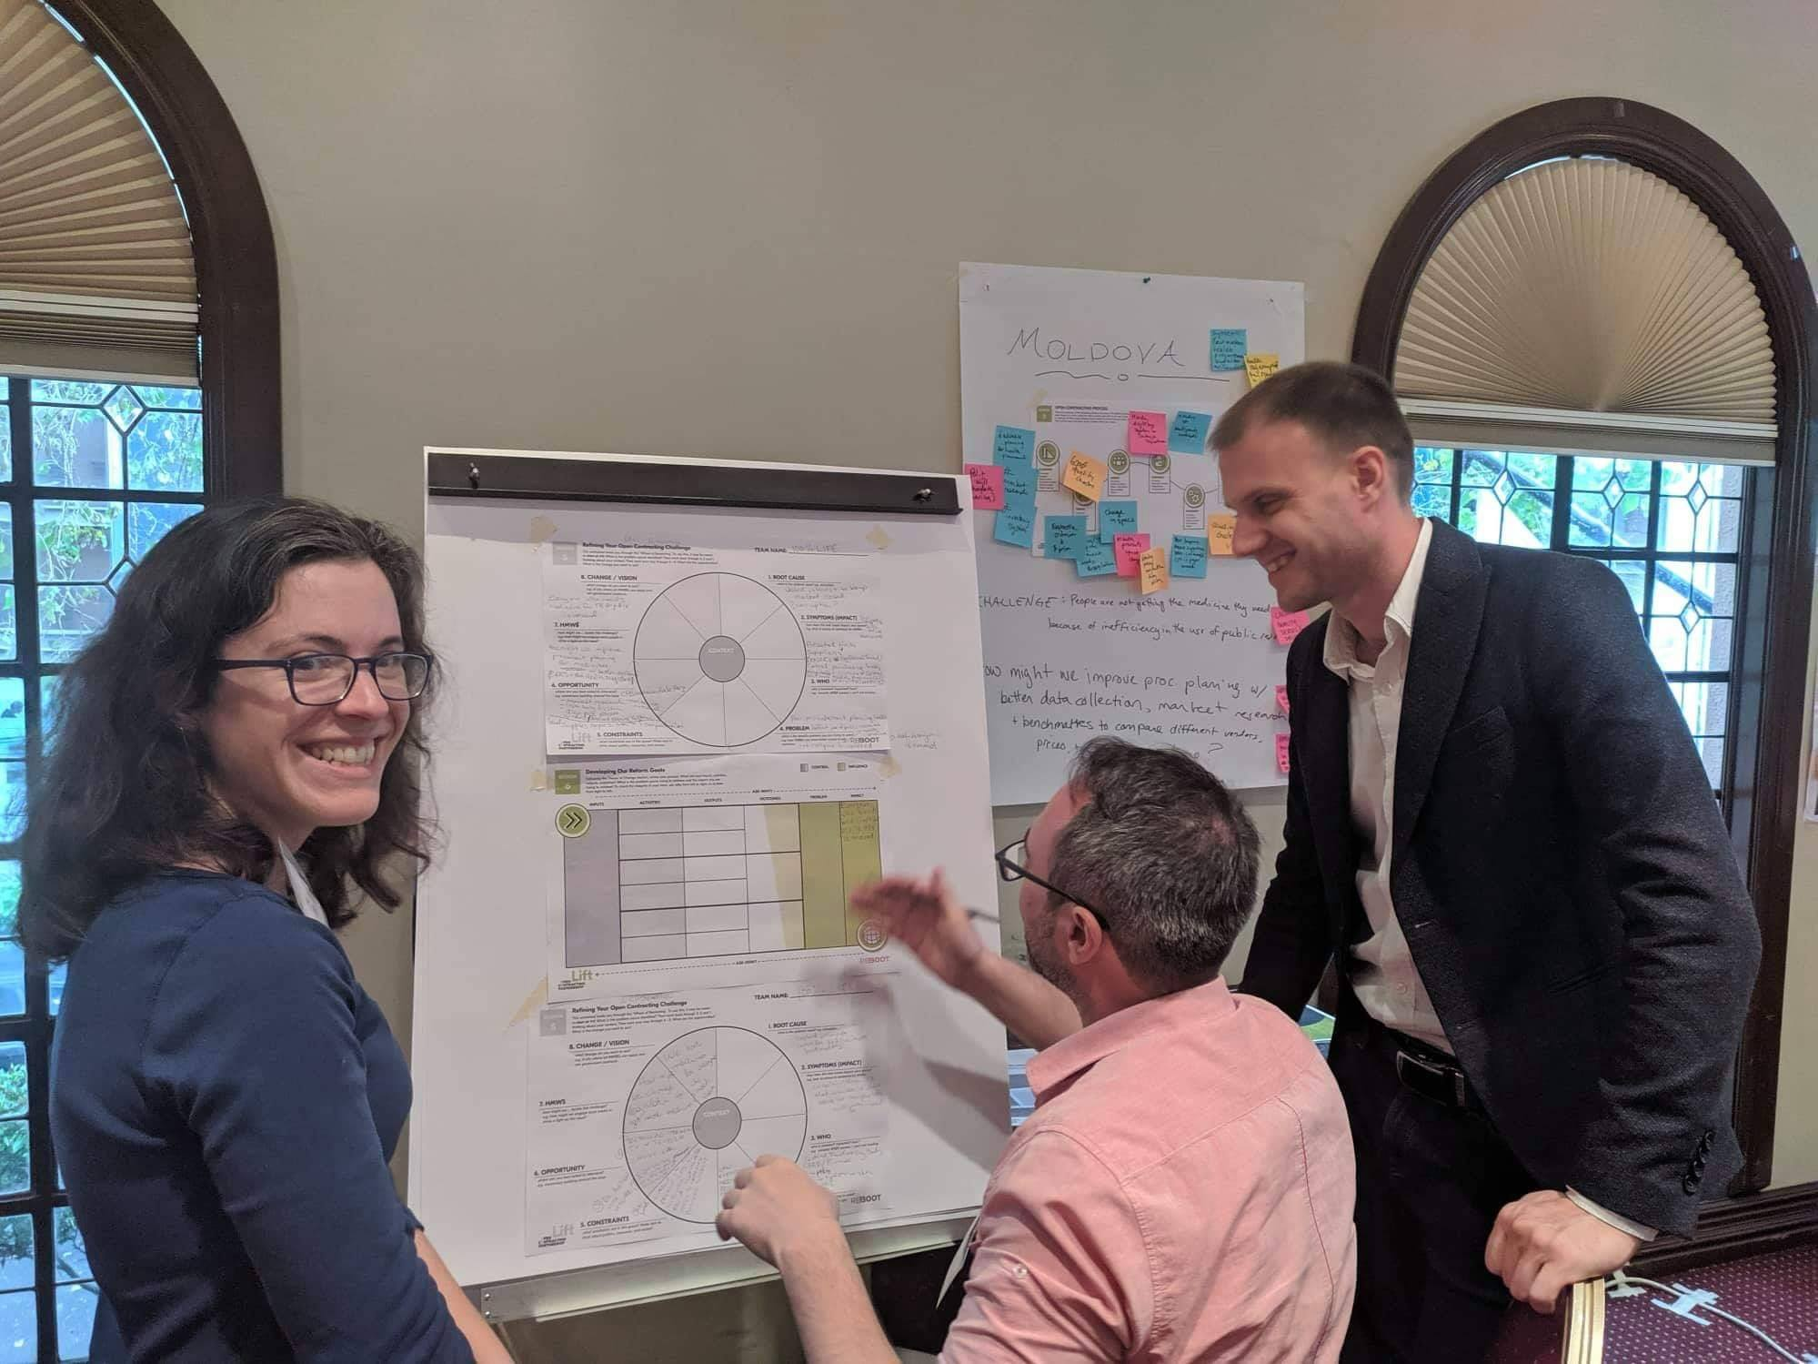
COVID-19 procurement & role of civil society: Republic of Moldova
Evghenii Alexandrovici GOLOȘCEAPOV, LL.M.,
Director of Advocacy Department,
NGO Positive Initiaitve

Slide 2
Procurement at the time of COVID-19
State of emergency in Moldova: 17 March – 15 May 2020
Exceptions and maximum flexibility in the procurement rules:
Both centralized and decentralized procurement
Direct contracting

Slide 3
Cooperation at the time of COVID-19
COVID-19
CIVIL SOCIETY
AUTHORITIES

Slide 4
31.03.2020

Slide 5
08.05.2020

Slide 6
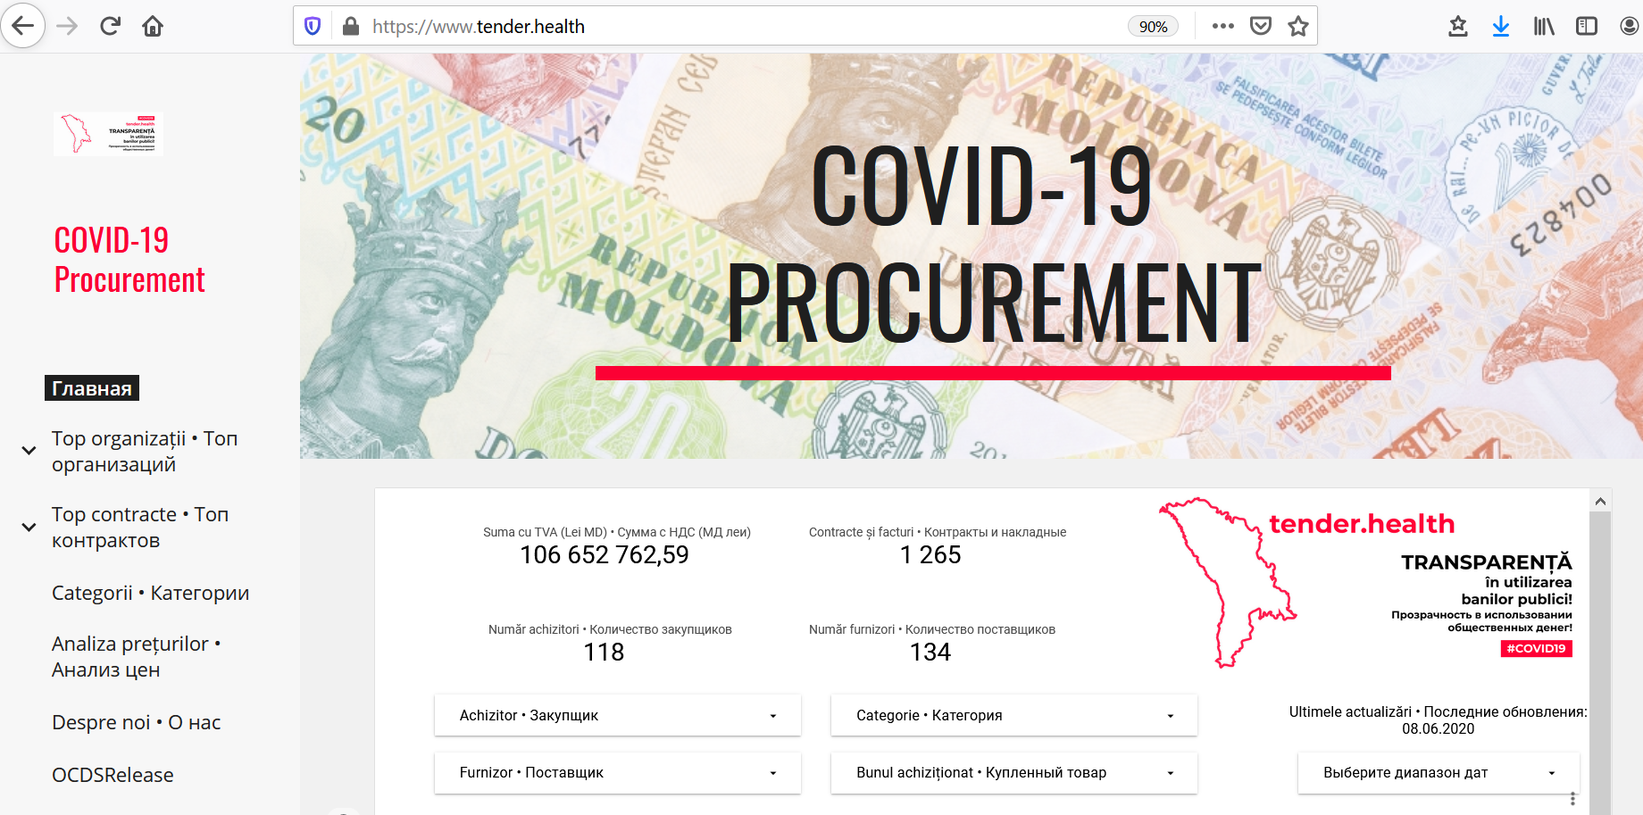

Slide 7
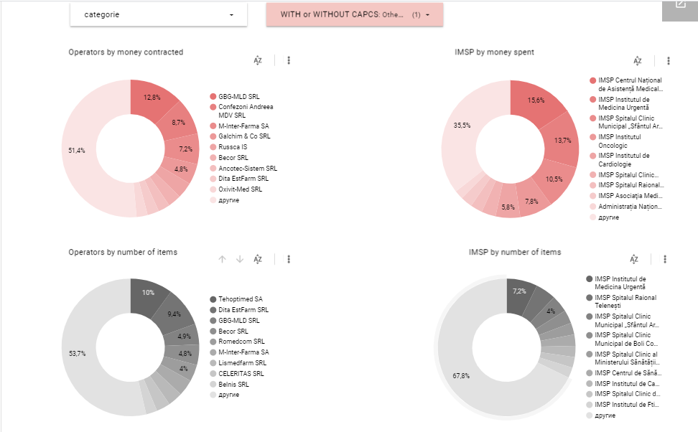

Slide 8
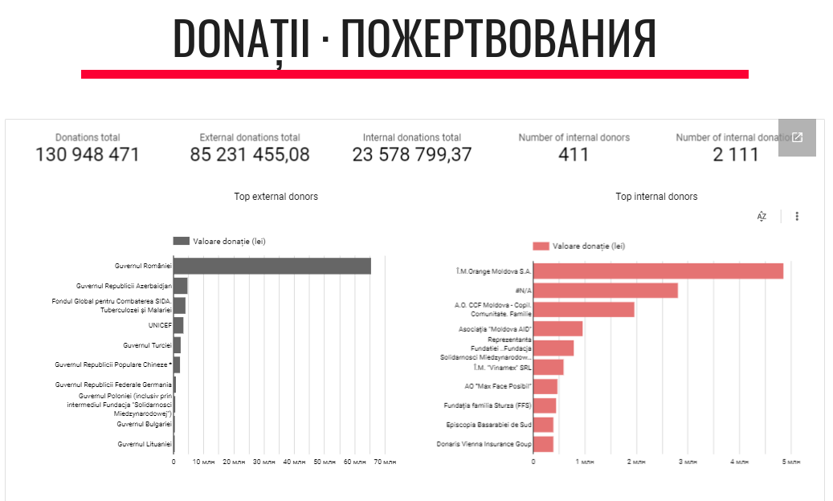

Slide 9
Challenges
MTender e-procurement system was not used by medical institutions
Weak accountability and reporting of medical institutions
Out of 381 only 118 have reported and 250 have not
Data was reported and collected in different ways and formats
Data was not published
Delays in the delivery of some procured goods

Slide 10
Looking forward
STOCK MANGEMENT SYSTEM

