Slide 1
Public procurement in the Kyrgyz Republic
“Precedent OO” Partnership Group
Edil Eraliev

Slide 2
FIELDS OF WORK
Public procurement monitoring
Training and legal support for civil society
Legal education
Participation in the legislative process

Slide 3
1. Public procurement monitoring (from August 2020 to February 2021)
Monitoring check list
Procurements above 500 000 KGS
(5 800 USD)
1. Lack of information about the contract concluded with the supplier
2. Combining of unrelated procurement items into one lot
3. Indication of certain brands, trademarks, logos in lots/description of the procurement items/technical specifications
Public procurement

Slide 4
1. Public procurement monitoring (from August 2020 to February 2021) WORK WITH OPEN SOURCES (affiliation analysis)
Monitoring check list
Procurements above 500 000 KGS
(5 800USD)
1. Search for information about the winning company on the Internet
2. Database of legal entities of the Ministry of Justice of the Kyrgyz Republic and www.osoo.kg
3. Other open sources: receipts to the state budget of tax and other deductions from the company (https://budget.okmot.kg/ru), information on the tax service website (https://salyk.kg/TaxPayer/Info), etc.
Public procurement

Slide 5
1. Public procurement monitoring

Slide 6
1. Public procurement monitoring

Slide 7
1. Public procurement monitoring
Public procurement monitoring
1. Public procurement monitoring
Identification of violations and sending the appeals to the Public Procurement Department with a description of violations and proposals on how to fix them
2. Information education. We launched a number of articles that dealt directly with the identified violations by procuring entities and regarding the shortcomings of the public procurement portal
3. Legislative proposal on introduction of liability for violations identified in preparation, conduct and evaluation of public procurement. Our proposal is reflected in the new code of offenses

Slide 8
2. Training and legal support for civil society
Training and legal support
for civil society
1. Team of “Precedent” is aware of the latest changes in the regulatory legal acts and monitors the legislative initiatives in the field of public procurement
2. Training on public procurement monitoring for civil society representatives (online/offline)
3. Legal support for representatives of civil society, including protection from prosecution during conduction of journalistic investigations

Slide 9
2. Training and legal support for civil society
Training and legal support
for civil society
2. Training on public procurement monitoring for representatives of civil society
Development together with Open Contracting Partnership
of a training module on public procurement
consisting of 15 topics

Slide 10
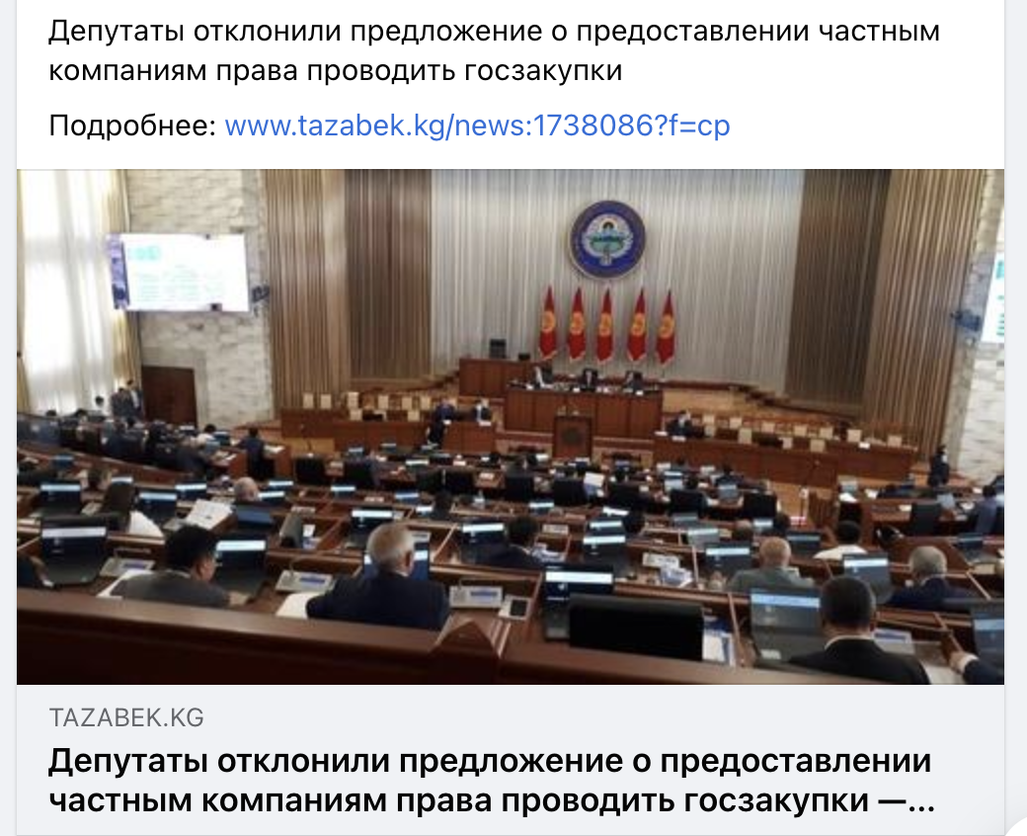
2. Training and legal support for civil society
Training and legal support for civil society
3. Legal support for civil society representatives
Example #1. One example of successful advocacy.
Over 50 civil defense organizations signed the appeal
President of the Kyrgyz Republic
Sadyr Nurgozhoevich Zhaparov
COPY:
1. Speaker of Jogorku Kenesh
of the Kyrgyz Republic
Talant Turdumamatovich Mamytov
2. Chairman of the Cabinet of Ministers
Ulukbek Asamidinovich Maripov
3. Deputy Chairman of the Cabinet of Ministers
Minister of Economy and Finance
Akylbek Usenbekovich Japarov
From representatives of Civil Society Organizations
APPEAL
Dear Sadyr Nurgozhoevich!
We, representatives of civil society are concerned regarding the initiative of the Cabinet of Ministers
and draft law “On introduction of amendments into the law “On Public Procurement”, prepared by the Ministry
of Economy and Finance (hereinafter referred to as MEF), according to which it is proposed to conduct all
procurements through private electronic trading platforms (hereinafter referred to as ETP)
Deputies rejected the proposal on provision of the right to conduct public
procurement to private companies
More information: www.tazabek.kg/news:1738086?f=cp
TAZABEK.KG
Deputies rejected the proposal on provision of the right to conduct public
procurement to private companies

Slide 11
2. Training and legal support for civil society (Consultations during conduction of journalistic investigations)
Training and legal support
for civil society
3. Legal support for representatives of civil society, including the protection from prosecution during conduction of journalistic investigations
Consultations during conduction of journalistic investigations
Protection from persecution

Slide 12
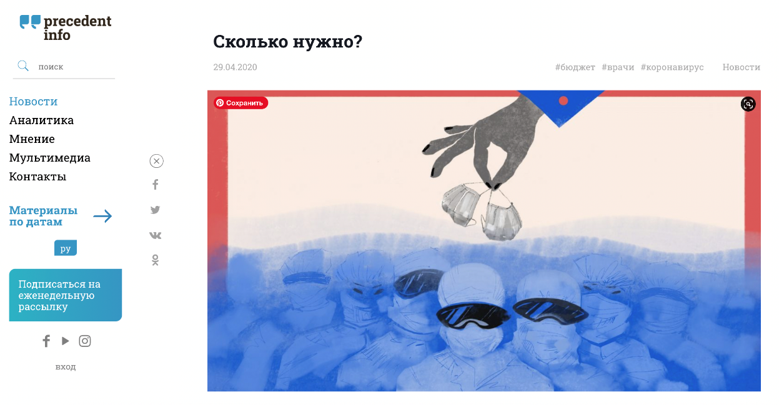
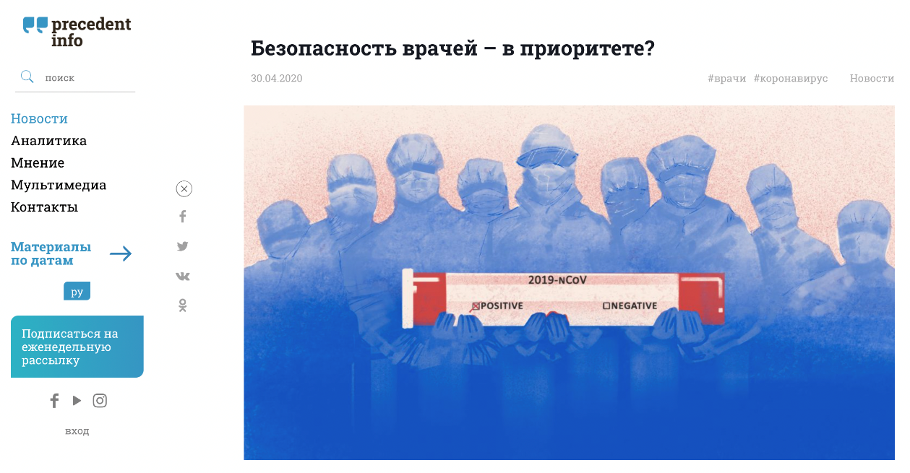
3. Legal education
Analytical materials
Informative articles on the current events

Slide 13
4. Participation in the law-making process
Participation in the law-making process
1. Monitoring of law-making initiatives
2. Preparation of legal expertise/analysis
3. Referral to legislative bodies, publication
of analytical materials in the social networks, advocacy

Slide 14
4. Participation in the law-making process
Legislative proposal on introduction of liability for violations identified in preparation, conduction and evaluation of public procurement. Our proposal is reflected in the new code of offenses
Precedent’s legal analysis and appeals of the civil society regarding the legislative initiative of the Cabinet of Ministers, which offered to perform public procurement through private electronic trading platforms.
Result: rejected by parliament
Legal analysis of the draft law “On Public Procurement", developed by the Ministry of Finance of the Kyrgyz Republic and published on November 27, 2021 for public discussion

Slide 15
Thank you for attention!
“Precedent OO” Partnership Group
Website http://precedentinfo.kg/
Facebook Precedentinfo
Instagram Precedentinfo
YouTube Precedentinfo
E-mail:precedentinfo@gmail.com
Direction coordinator - Edil Eraliev (+995 557 49 49 37 - WhatsApp, Telegram, Signal)

