Slide 1

GPA Observers: benefits and privileges for non-WTO Members
Antonella Salgueiro
EBRD GPA TC Facility

Slide 2
Increasing membership and geo-location shift of Parties and Observers
22 PARTIES
GPA 2012
Covering 49 WTO members, including the EU and its 27 member states as one party
North Macedonia became 49TH Party
35 Observers
North Macedonia’s terms of accession approved in June 2023
7 (11) more currently seeking accession
Four WTO Members w/ commitment to seek accession
Albania, Costa Rica, China, Kazakhstan, Kyrgyz Republic, Russian Federation, and Tajikistan
Dominican Republic in 2023
Côte d’Ivoire in 2020
Ecuador, Paraguay and the Philippines in 2019
Belarus in 2018
+ 5 international organizations
Afghanistan, Mongolia, Saudi Arabia and Seychelles
Notes:
Georgia Jordan and Oman with prolonged inactivity on their accession process and Brazil withdrew their revised market access offer, though this does not mean that it withdrew its applciations, it may, if decided return to the accession process at a later stage.

Slide 3
A growing Plurilateral means…
Parties to the Agreement + new Parties: Ukraine, Armenia, Moldova, North Macedonia
CIS Region & Russia
Active accession negotiations:
Russia
Tajikistan
Kyrgyz Republic
Canada and the US
East Asia
China looking to accede
Parties from the American continent
Seychelles
LATAM
Commitment to accede to the GPA
Interest slowly shifting to the region: new Observers and Accession negotiation
Australia
Party since 2019
That the GPA 2012 covered procurement market is large and expanding!

Slide 4
The GPA 2012: key facts relevant to becoming an observer and for later accession
The GPA 2012 is a plurilateral agreement, which means that it is binding only on those WTO Members that have accepted to be bound by it
The GPA provides a framework for the conduct of international trade in government procurement markets among the participating Parties
It also serves broader purposes of promoting the efficient and effective management of public resources, through facilitating good governance, open and fair competition and, ultimately, the attainment of value for money in national procurement systems

Slide 5
Observer Status on the Committee on Government Procurement
In the Ministerial-Level Decision of the Committee concluding the GPA renegotiations that was adopted on 15 December 2011, the Ministers of the GPA Parties invited "all WTO Members that are not Parties to the Agreement to become Observers to the Committee on Government Procurement in order to become familiar with the opportunities that membership can provide, and to consider joining the revised Agreement”
Pursuant to Article XXI:4 of the amended Agreement, any WTO Member not Party to the GPA may participate in the Committee in an observer capacity as a matter of legal right

Slide 6
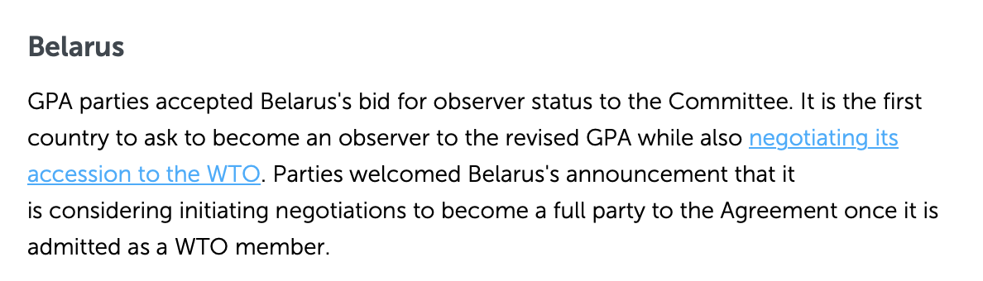
Observer status: does the country need to be already a WTO member?
NO!
Article XXI:4
Any WTO observer may submit a written request to the Committee to participate in the Committee as an observer, and may be accorded observer status by the Committee

Slide 7

Rights Related to Observer Status
Observer status in the GPA Committee provides an opportunity for the observer to participate in (most) discussions in the Committee, including on accession proceedings
Gain access to relevant information: receiving directly information regarding accessions, upcoming meetings, meeting documents, and post-meeting summaries and reports
Notes:
Growing importance of public procurement in the current policy debates

Slide 8
Rights Related to Observer Status
Getting to know and understanding the minimum standards of the GPA 2012:
National treatment and non-discrimination;
Key aspects of the procurement process, ensuring transparency and open competition;
Transparency;
Minimum time periods for submitting tenders or appealing;
Domestic review procedures;
Flexibilities for developing countries and LDCsa
And how these are implemened in national legislation, in order to assess interest in the GPA, as well as the relevance of the Agreement to its economy!
Become acquainted with the GPA provisions, operation and administration of the Agreement
Eventually, participating in the discussions on the built-in mandate for future negotiations to improve/update/broaden the Agreement’s reach

Slide 9
Rights Related to Observer Status
GPA considered as the gold standard for agreements covering government procurement:
  Moving away from the lowest price to the most advantegeous tender
  Transparency requirements: publication of tenders, notifications, publication of awards, information to non-succesful tenderers
  Good governance aspect: preventing corruption and avoiding conflict of interests, procurement in anti-corruption legislations
  Open procurement becoming the standard, rather than limited or selective procurement to promote competition
  Use of electronic procurement
Procurement chapters in FTAs are modelled after the GPA 2012! And harmonized with the UNCITRAL ML on PP
Learn about other trending topics and issues in procurements:
  Sustainable procurement (specially green public procurement)
  Ensuring the participation of SMEs without infringing trade obligations (offsets)
Learn from international best practices and latest trends through the Committee discussions and the GPA Work Programmes (e.g. on SMEs participation and sustainable procurement)

Slide 10

Obligations Related to Observer Status
Observer status by itself does not impose any obligation on an observer with regard to accession to the Agreement!
No need to divulge information on the country’s public procurement framework
No need to demonstrate compliance with GPA
Notes:
No commitment to accede to the agreement, to be present at the Committee Meetings, to divulge information on the countries' public procurement regime.

Slide 11
Obtaining Observer Status on the Committee
on Government Procurement
Decision by the Government to become an Observer
The process to become an observer to the GPA is a very simple one
Decision taken by Parties at next Committee Meeting
Submit request letter to the Chairman of the Committee
The request is considered by all Parties
1
Permanent Representative of the interested country to send the request to the Committee Chairman, with a copy to the Secretary to the Committee
New Observer at the Committee
3
Automatically obtains all rights and benefits, no obligation to accede
2
4

Slide 12
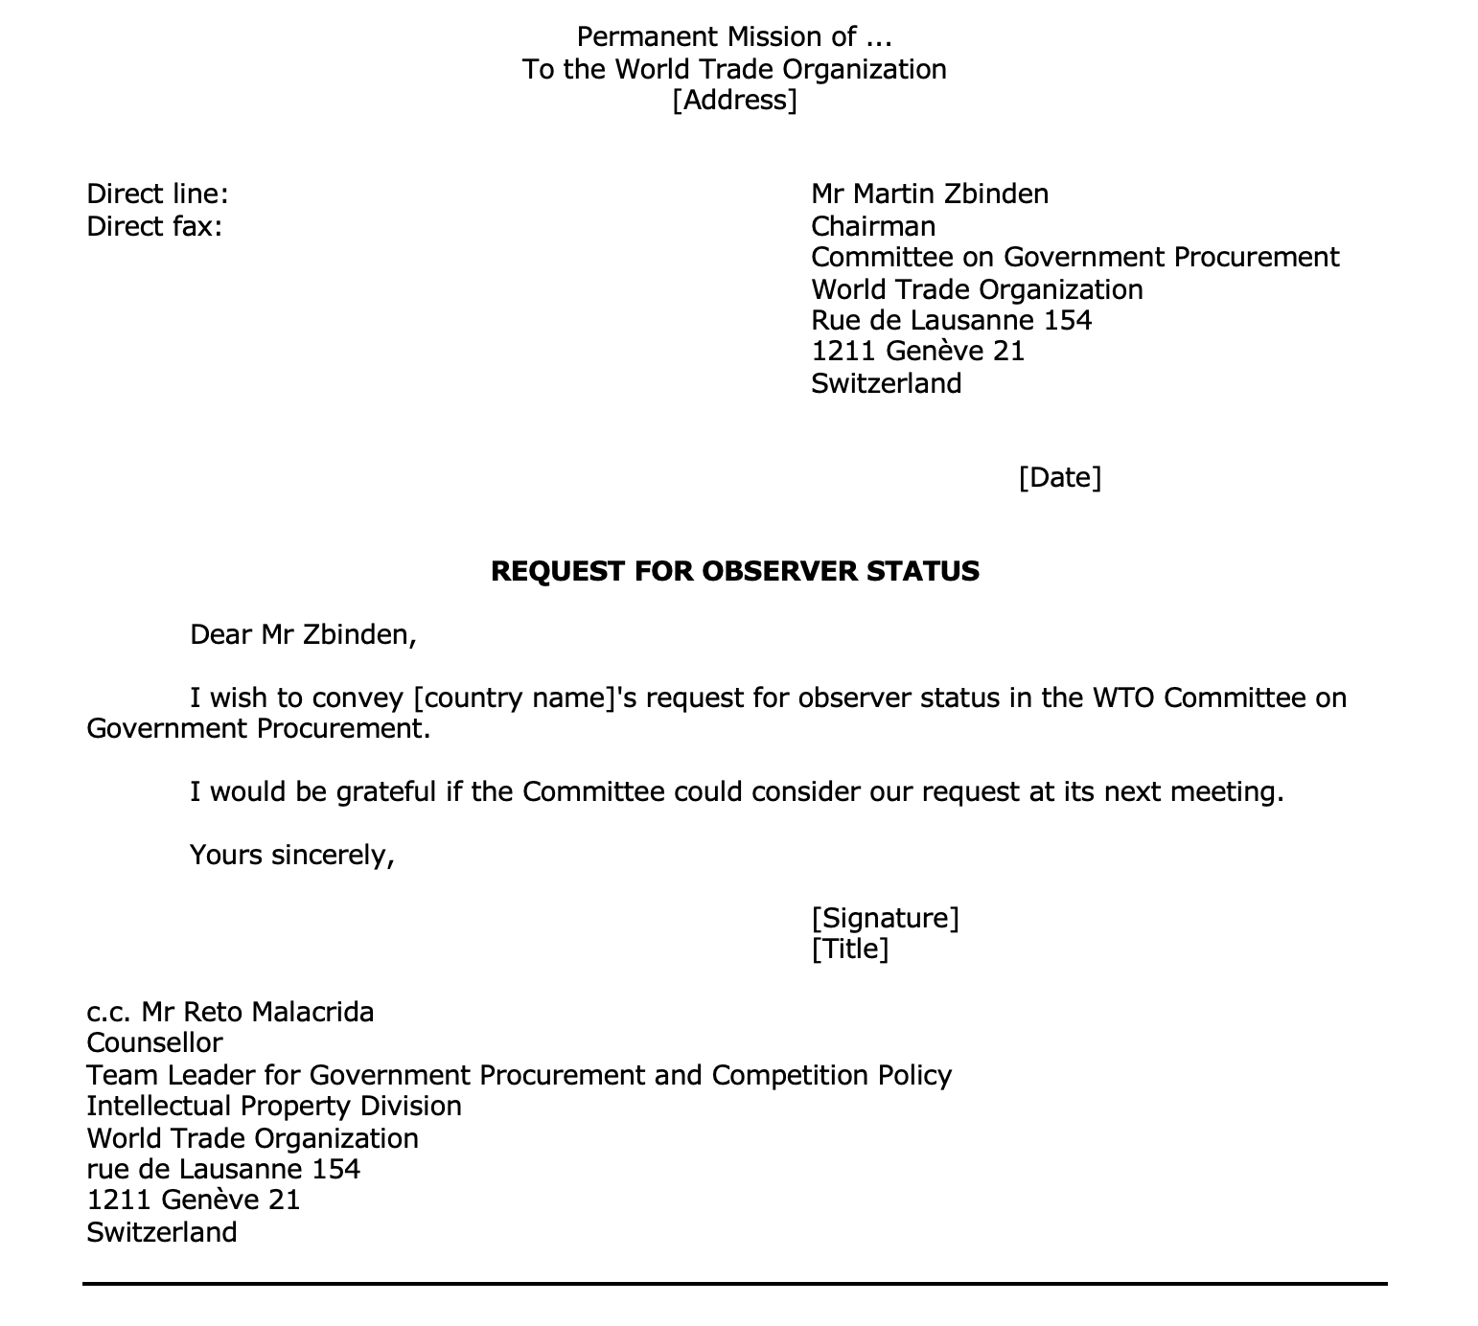
Obtaining Observer Status on the Committee
on Government Procurement

Slide 13
The GPA Accession as a driving force for reform!
Update of procurement legislation to include new regulatory techniques and methods of procurement
Introduction of electronic procurement, access to data and statistics – oversight and monitoring tool
Establishment of independent domestic review bodies and regulatory institutions
GPA Membership means international recognition and proof that procurement legislation is compliant with best practices
The Armenia experience: small market, big reforms, GPA Party since 2011

Slide 14
EBRD GPA Technical Cooperation Facility
Supporting countries to achieve transparent, open procurement markets delivering value for money for governments, business and citizens and benefitting from international trade opportunities
EBRD Legal Transition Programme
Five Bank Street
London E14 4BG
United Kingdom
Tel: +44 20 7338 7190
More information: http://ebrd-gpa-facility.com
European Bank for Reconstruction and Development
Five Bank Street London E14 4BG, United Kingdom
www.ebrd.com
World Trade Organization Centre William Rappard
Rue de Lausanne 154 Case postale
1211 Genève 21, Switzerland
www.wto.org

