Slide 1
The EU and the GPA
Bogna Krysinska, Team Leader,
Access to International Procurement Markets
European Commission

Slide 2
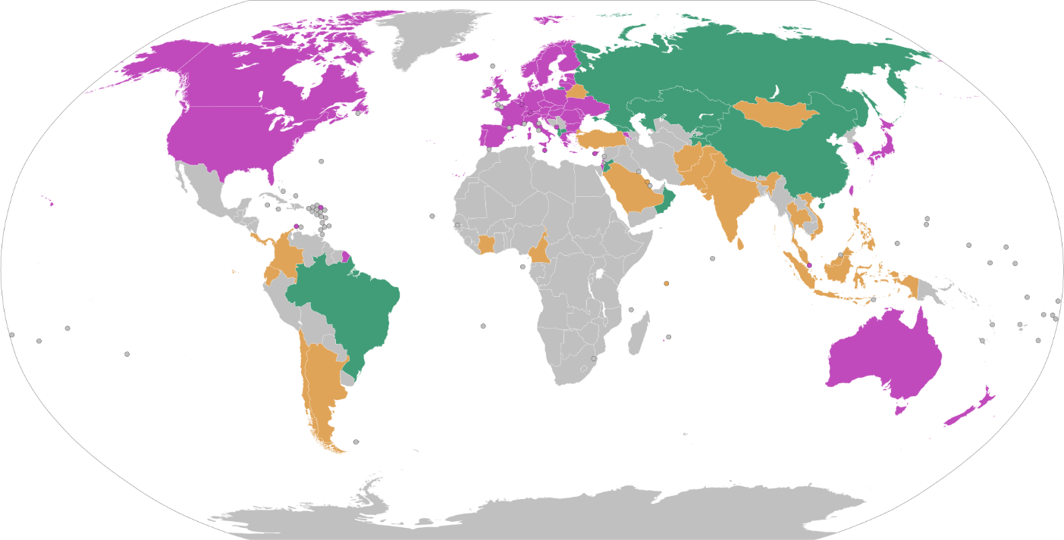
The Government Procurement Agreement (GPA)
A binding international agreement that promotes:
Access to other GPA Parties’ procurement markets
Good governance (transparency, fair competition, prevention of corruption)
2 Parts:
Rules
Market access commitments

Slide 3
Functioning of the GPA
GPA contains provisions to open procurement markets, but they are not granted to each Party on the same terms – depends on reciprocity of the opening
Each Party has a coverage schedule defining:
procuring entities covered by GPA
goods, services and construction covered by GPA
the threshold values above which procurement activities are covered by GPA
exceptions to the coverage – so called reservations
Acceding Parties shall be deemed GPA-compliant and have their market access offer accepted by current Parties.

Slide 4
GPA Basic Principles and Elements (I)
Guarantees of national treatment and non-discrimination for the suppliers of parties to the Agreement with respect to procurement of covered goods, services and construction services as set out in each party's schedules
Provisions regarding accession to the Agreement and the availability of special and differential treatment for developing and least-developed countries
Detailed procedural requirements regarding the procurement process designed to ensure that covered procurement under the Agreement is carried out in a transparent and competitive manner that does not discriminate against the goods, services or suppliers of other parties

Slide 5
GPA Basic Principles and Elements (II)
Additional requirements regarding transparency of procurement-related information (e.g. relevant statutes and regulations)
Provisions regarding modifications and rectifications of parties' coverage commitments
Requirements regarding the availability and nature of domestic review procedures for supplier challenges which must be put in place by all parties to the Agreement
Provisions regarding the application of the WTO Dispute Settlement Understanding in this area
A “built-in agenda” for improvement of the Agreement, extension of coverage and elimination of remaining discriminatory measures through further negotiations.

Slide 6
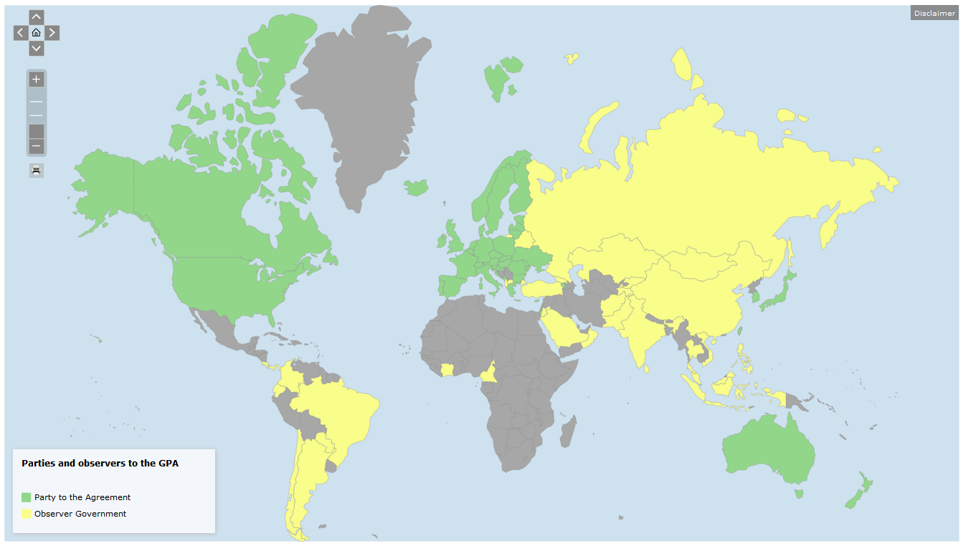
GPA Parties and Observers
Notes:
The Agreement on Government Procurement (GPA 2012) consists of 21 parties covering 48 WTO members (counting the European Union and its 27 member states, as one party).
Another 35 WTO members/observers and four international organizations participate in the Committee on Government Procurement as observers.
Eleven of these members with observer status are in the process of acceding to the Agreement.

Slide 7
GPA Parties and Observers
22 GPA Parties:
Armenia; Australia; Canada; European Union with regard to its 27 Member States; Hong Kong China; Iceland; Israel; Japan; Korea, Liechtenstein; Republic of Moldova; Montenegro; Netherlands with respect to Aruba; New Zealand; Republic of North Macedonia; Norway; Singapore; Switzerland; Chinese Taipei; Ukraine; United Kingdom; United States
35 Observers
10 WTO Parties in process of GPA accession:
Albania; Brazil; China; Georgia; Jordan; Kazakhstan; Kyrgyz Republic; Oman; Russian Federation; Tajikistan
Notes:
GPA is one of the few WTO working tools creating new opportunities in public procurement markets for European and other GPA-countries companies.
With the latest accession of Australia, estimated at EUR 69 billion (AUD 110 billion), the GPA parties have opened procurement activities worth an estimated USD 1.7 trillion annually to international competition (i.e. to suppliers from GPA parties offering goods, services or construction services).
The EU is by far the largest public procurement market, with approx. EUR 352 billion covered by the GPA and therefore open to bidders originating in the other GPA Parties.
The value of American procurement offered to foreign bidders is calculated at EUR 178 billion, for Japan that figure is only EUR 27 billion.
Currently important accessions in the pipeline: China, Brazil, Russia, others…

Slide 8
Observership at the GPA – Opportunities
Who: Any WTO member may participate as an observer by submitting a written notice to the Committee. Any WTO observer may submit a written request, and may be accorded observer status by the Committee.
Why: Opportunity to get familiar with the Agreement, to follow the Committee's work and to learn about international best practices in the area of government procurement.

Slide 9
The EU and the GPA
The EU is one of the founding members of the GPA
Strong supporter of a rules-based, multilateral system
Advocate of new accessions to the GPA

Slide 10
Legal framework
Directives 2014/24 on PP, 2014/25 on utilities PP, 2014/23 on concessions;
Remedies Directives
EU sectorial legislation
WTO Government Procurement Agreement
CJEU case-law

Slide 11
Goals of EU public procurement policy
Guaranteeing and fostering competition
Enabling public buyers to make the most
efficient use of public funds
Enabling public buyers to support sustainable procurement and policy goals through PP

Slide 12
Thank you for your attention! Any questions?

