Slide 1
EBRD GPA
Technical Cooperation Facility
Government procurement constitutes a significant share of public expenditure, approximately 10-15 per cent of the GDP. Government procurement policies support good governance in the public sector and national strategies for sustainable development of domestic economies. Fair competition and transparency of cross-border public procurement is essential for access to and quality of public services and infrastructure.
The Legal Transition Programme (LTP) of the European Bank for Reconstruction and Development (EBRD) focuses on the development of legal rules and the establishment of legal institutions that create a transparent and predictable
investment climate in the economies the Bank operates.
Promoting private sector development, the LTP is helping governments to improve government commerce, making national procurement systems more transparent, efficient and competitive.
The fundamental aim of the GPA is to mutually open government procurement markets among its Parties, while ensuring open, fair and transparent conditions of competition in cross-border public procurement.
The adoption of the revised text of the GPA in 2012 motivated a broadening of its membership.
Growing interest in GPA accession in the transition economies demanded a structured cooperation between the EBRD and the WTO Secretariat.
The EBRD GPA TC Facility provides technical support to governments seeking accession or observership to the Agreement in the form of (1) capacity building activities,
(2) country-specific technical cooperation projects, (3) accession negotiation assistance to countries wishing to accede to the Agreement, (4) implementation of GPA rules and commitments.
Technical support aims to assist governments with overcoming institutional, regulatory and/ or trade policy challenges in cross-border public procurement.
What is the GPA?
The GPA is a plurilateral agreement within the framework of the WTO, meaning that not all WTO members are Parties to the Agreement, only those who have voluntarily decided to become one. In March 2012, the GPA Parties completed a comprehensive revision
of the Agreement, encompassing both its text and coverage (market
access commitments). The Agreement establishes rules requiring that open, fair and transparent conditions of competition be ensured in government procurement. However, these rules
do not automatically apply to all procurement activities of each Party. Rather, the coverage schedules play a critical role in determining whether a procurement activity is covered by the Agreement or not. Only those
procurement activities that are carried out by covered entities purchasing listed goods, services or construction services of a value exceeding specified threshold values are covered by the Agreement. As a binding international treaty, the GPA is administered by
the Committee on Government Procurement which is composed of representatives of all its Parties.
Access the text of the revised GPA and WTO related legal instruments and e-GPA market access portal.
Why join the GPA?
The continuing growth of GPA membership and its role as an instrument of good governance attracts wide range of economies looking to become Observer and Parties to the Agreement.
The GPA is, first and foremost, a trade instrument designed to open government procurement markets among its Parties, around the same core principles of
non-discrimination and transparency that underlie all WTO Agreements. Additionally, the GPA is widely regarded as a modern instrument embracing and incentivising the use of best practices in government procurement internationally. As such, the Agreement has gained an important role in guiding policy reforms, particularly in transition economies. The revised GPA text crystallises current best practices in government procurement agreed upon by and acceptable to all GPA Parties and is harmonised with other applicable international instruments, including the latest EU directives on public procurement and the UNCITRAL Model Law on Public Procurement. It therefore complements other efforts by some developing economies to reform their procurement systems.

Slide 2
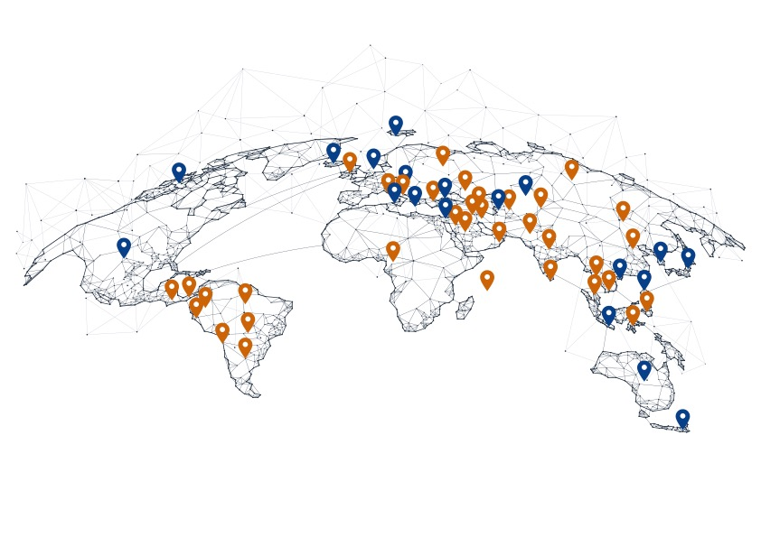
GPA Parties
GPA Observers
International investor expertise in facilitating cross-border trade
Out of the seven countries that have become GPA Parties in the last decade, four gained accession with assistance from the EBRD: Montenegro in 2015, Moldova and Ukraine in 2016 and North Macedonia in 2023. With support from the Bank, Armenia ratified the GPA 2012 in 2017 . Currently, the EBRD GPA TC Facility is supporting the Government of Albania in relaunching their GPA negotiations.
Promoting development of private sector, the EBRD advocates benefits of the WTO GPA 2012 rules on cross-border public procurement to transition economies.
Upon request of the interested governments, the EBRD collaborates with the WTO Secretariat to develop and deliver country-tailored technical cooperation projects for the benefit of the transition economies.
The Bank provides independent legal gap analysis and market impact assessment as well as capacity building on regulatory frameworks for cross-border public procurement.
If relevant and of interest to transition economies, the Bank is assisting countries with their request for GPA observership,
When GPA accession is feasible, the Bank helps countries negotiate the terms of their GPA accession by providing experts and policy advisers supporting development of acceptable market access coverage offers, determining procurement activities and/or entities to be covered by the Agreement and the possibility of implementing special and differential treatment provisions (S&D) available to developing and least developed economies acceding to the GPA, subject to negotiations with the GPA Parties.
The EBRD GPA TC Facility is available to all EBRD countries of operations.
How to become a GPA Party
All WTO members are eligible to accede to the GPA. Countries must submit
an application for accession and later conduct accession negotiations with Parties of the GPA considering the following aspects: consensus between the GPA Parties and the acceding country on the extent and modalities of the proposed market access coverage offer and compliance of the procurement legislation of the acceding country with the GPA’s mandatory requirements.
Besides providing its initial market acccess offer, in order to facilitate consultations relating to accession, negotiating economies also provide a description of the government’s procurement regime by replying to a standardised checklist of issues.
Market access negotiations and discussions on possible necessary amendments of the procurement legislation and/or institutional system of an acceding country may be conducted in parallel in order to save time and decrease overall time of negotiations.
Additionally, in line with Article V of the GPA, special and differential treatment for developing economies can be negotiated by developing and least developed economies. These options are subject to the agreement of the other GPA Parties and the acceding WTO member’s development needs.
Once the terms of accession have been agreed between the GPA Parties and the acceding WTO Member, the Committee on Government Procurement adopts a decision inviting the member to accede to the GPA. The decision specifies the agreed terms and provides a timeframe
– typically, three to six months - for the acceding member to deposit its instrument of accession with the WTO Director-General.

Slide 3
Why to become an Observer to the Committee on Government Procurement?
The Observer status in the Committee on Government Procurement provides an opportunity for the observer country
to participate in the Committee’s discussions and policy standard-setting, gain access to key cross-border trade documents, and become acquainted with the operation and administration of the Agreement, without undertaking
any obligations with regard to accession to the GPA.
Observers may participate in the Committee, however, decisions in trade negotiations shall be taken only by Parties.
International organisations may also participate in the Committee meetings as observers.
Intended for WTO Members, is also available to other interested countries/ governments upon endorsement of the Committee.
About the EBRD
The European Bank for Reconstruction and Development is an international financial institution that promotes transition to a well-functioning market economy. The Bank, active in 38 economies across three continents
– from the Southern and Eastern Mediterranean, to Central and Eastern Europe, to Central Asia – helps economies develop commercial laws and institutions that create a sound investment climate and promote
sustainable economic growth.
More information can be found at
www.ebrd.com
About the WTO
The World Trade Organization is an intergovernmental organization whose primary purpose is to open trade, ensuring that it flows as smoothly, predictably and freely as possible. It acts as a forum for its Member governments to negotiate trade agreements while operating a system of trade rules. At its core are the WTO agreements, negotiated and signed by the bulk of the world’s trading nations. These agreements provide the legal ground rules for international commerce.
More information can be found at
www.wto.org
For more information about our services, please go to: www.gpafacility.com

