Slide 1
Public Procurement for the SDGs: Perspectives from the UN
Elisabeth Türk,
Director,
Economic Cooperation and Trade Division, UNECE

Slide 2
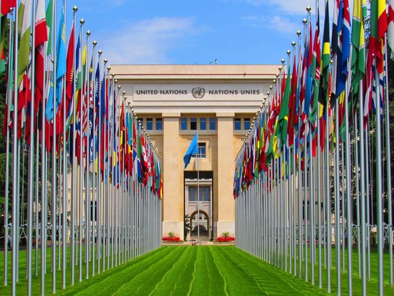
UNECE: Economic Cooperation and Trade Division
Harnessing trade, investment, and innovation for SDGs
ONE Vision:
Harnessing Trade, Investment, and Innovation for the SDGs
17 Programme Countries:
Central Asia, Southern Caucasus, Western Balkan, Eastern Europe
TWO Sub-programmes:
Sub-programme 4: Economic Cooperation and Integration
Sub-programme 6: Trade
THREE Cross-cutting Themes:
Circular Economy and the Sustainable Use of Natural Resources
Digital and Green Transformations
Support for Gender Equality/SMEs
FOUR Sections:
Cooperation and Partnerships Section
Innovative Policies Development Section
Market Access Section
Trade Facilitation Section

Slide 3
UNFSS
United Nations Forum on Sustainability Standards
UNFSS is a neutral and credible platform to harness VSS potential to achieve the SDGs by:
Facilitating beneficiary countries’ access to global markets
Stimulating well-informed dialogue among key stakeholders at the national and international level
Elevating capacities for producers, SMEs and exporters, who can be marginalized by VSS in global trade

Slide 4
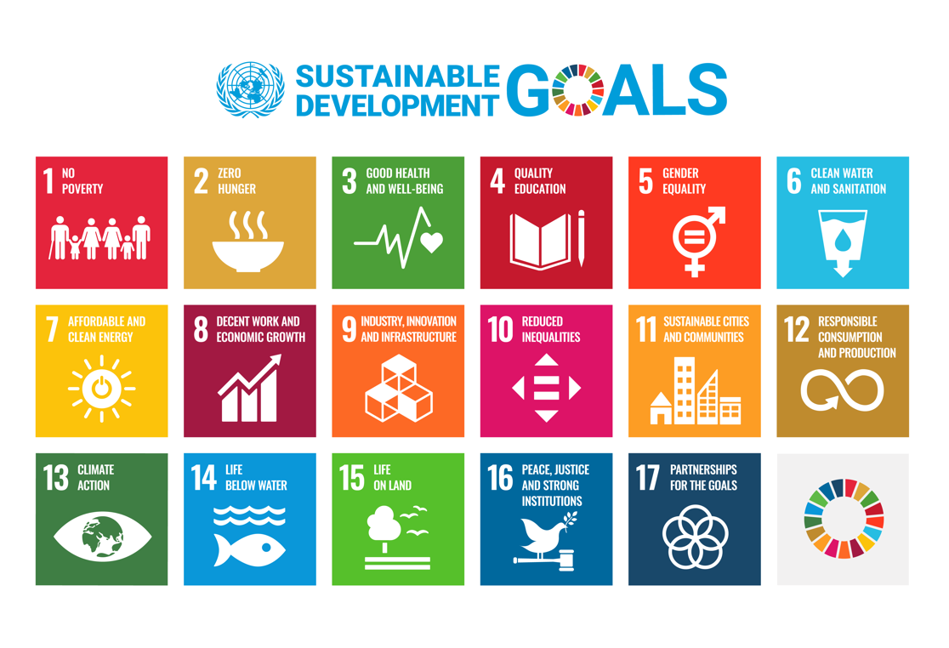

Slide 5
Part I:
Public Procurement and Voluntary Sustainability Standards

Slide 6
UNFSS and SPP
Sustainable Public Procurement
UNFSS 2020: Huge potential to nudge markets towards higher standards of sustainability
UNEP 2012: A process whereby organizations meet their needs for goods, services, works and utilities in a way that achieves value for money on a whole life basis in terms of generating benefits not only to the organizations, but also to society and the economy, whilst minimizing the damage to the environment
European Union: SPP based on key international conventions and commitments (Annex, e.g., ILO Conventions, Stockholm, Vienna)
Art 18(2) Directive 2014/24/EU (utilities operating in water, energy, transport, postal)
Art 36(2) Directive 2014/23/EU (concession contacts)

Slide 7
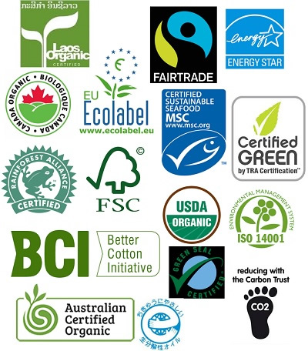
Trends
Voluntary Sustainability Standards
Evolution in the number of VSS

Slide 8
UNFSS 4th Flagship Report
Discussion and Insights
What accounts for the variation in VSS adoption amongst key countries?
What are the drivers for VSS uptake through sustainable public procurement and trade policy?
How can VSS support sustainable development and public procurement goals together?
What is the future of VSS considerations in future trade policy negotiations, especially from a developing country standpoint?

Slide 9
UNFSS 4th Flagship Report
Discussion and Insights
Key messages of UN FSS 4th Flagship Report (2020)
VSS can play an important role in progressing towards sustainable development
Next to many other tools, Public Procurement can help increase VSS uptake
How:
Use sustainability criteria in SPP
Use criteria like VSS standards
Recognize VSS as proof of compliance with tender criteria
VSS “shorthand” for procurement of sustainable products (buying guides)
Challenges:
Availability of VSS: some sectors have few (or none) VSS (e.g. health)
Address ‘Greenwashing’: credible versus non-credible VSS
Potential discrimination/exclusion: similar ESG performance but no certification

Slide 10
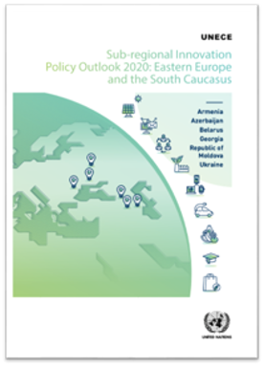
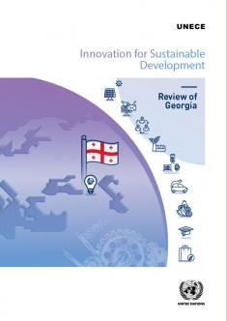
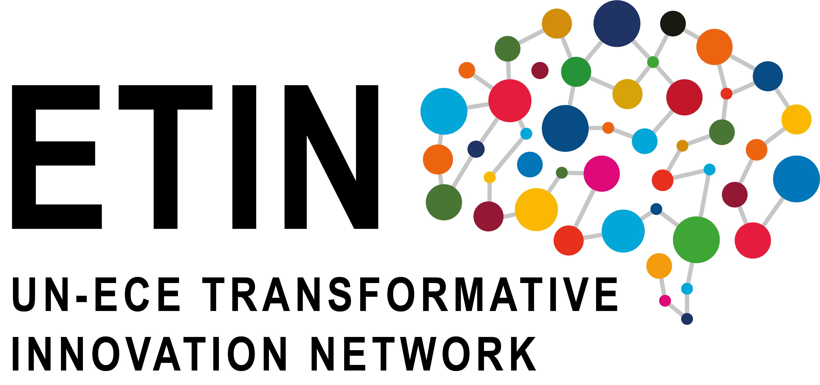
Part II:
UNECE: Innovation-Enhancing
Procurement (IEP)
Sub-regional Innovation Policy Outlook;
Innovation for Sustainable Development Review

Slide 11
Rethinking Procurement
How public procurement and standards can catalyse innovation?
How this catalyses innovation in practice
Innovation-Enhancing Procurement
City Parks as Community Hubs: Transition from fixed-fee contracts to payment based on impact (visitors).
Energy Efficiency in Buildings: Innovate beyond current technological limits.
Sanitation: Shift from quantity (toilets built) to quality (usage rates).
Impact and value at the center
Aligning private profit incentives with social impact and value closely
Flexible governance
Creating demonstration effects and other spill-overs
Success metrics
UNECE’s approach to procurement puts impact and value at the center and enables experimentation with ways to bring it about!

Slide 12
IEP
Innovation-Enhancing Procurement
What:
Public agency tenders for a good, service or technology that does not yet exist, providing solutions to an unmet policy need or challenge.
Benefits:
Can be a game changer by creating the conditions for creativity and innovation (governments as “lead customers”)
Characteristics:
Requires some form of innovation before delivery to the public agency of a solution that outperforms existing solutions.
Requires a shift from defining parameters in detail to specifying objectives and leaving bidders (that is, economic operators) substantial scope for proposing solutions.

Slide 14
Innovation-enhancing procurement in UNECE
UNECE projects consists of analytical work, network element, and follow-up capacity building
About the IPO Publication
Study Tour and Policy Handbook on Innovation-enhancing Procurement for Georgia
Public procurement, accounting for 10% of Georgia's GDP.
Capacity building work in Georgia delivered a study tour for procurement officials in Norway and a Policy Handbook on best practices
UNECE flagship that comprehensively assesses and compares innovation governance across initiatives countries with shared legacy and institutional features
Other Activities:
Interim Sub-regional Innovation Policy Outlook 2022: Eastern Europe and the South Caucasus
The Team of Specialists on Innovation and Competitiveness Policies (ToS-ICP) in 2021
Policy Paper: Leveraging Innovation for the Circular Economy
Advancing Circular Economy in Agri-food: Serbia's Initiatives
About the I4SDR for Georgia
Focus of I4SDR: assessing Innovation Systems, Policy Guidance, Sustainable Growth.
Georgia Review: chapters on innovation-enhancing procurement

Slide 15
UNECE and the Western Balkans
UNECE sees great potential in focusing on innovation in the Western Balkans
Benefits for Western Balkans
Support competitiveness for EU accession
Stressing the fundamental role of innovation governance
Deeper understanding of failures of innovation support initiatives
Peer-learning dynamic: pilot IPO & ETIN
Western Balkans underperform in innovation
66.6% of the EU average*
91.7% of the world average*
*According to the Global Innovation Index (2021)

Slide 16
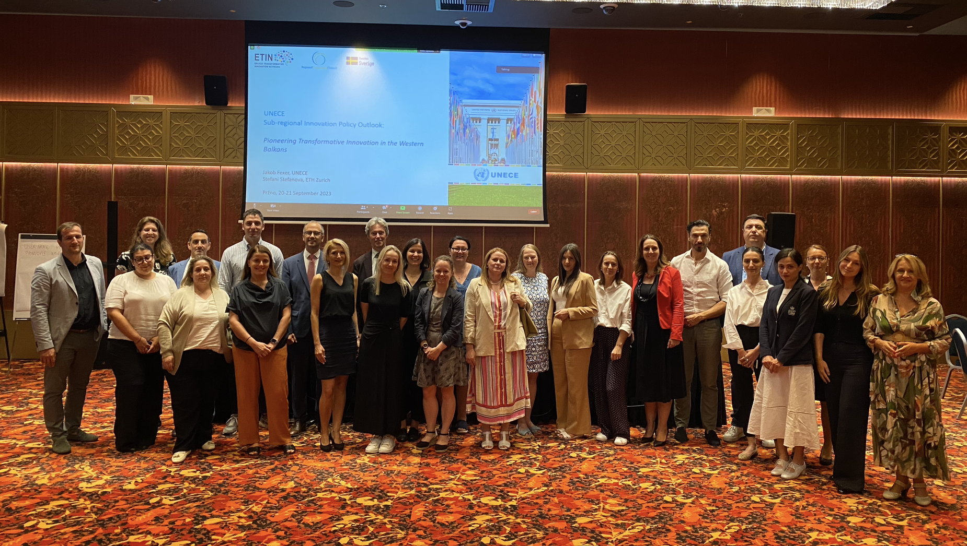
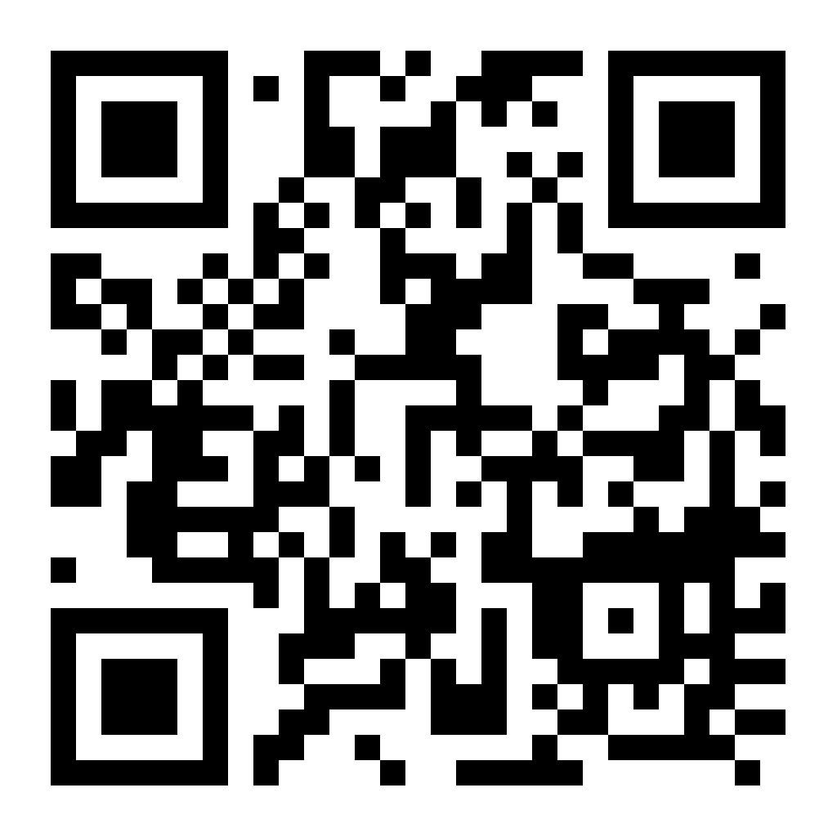
ETIN
UN-ECE Transformative Innovation Network – work with the Western Balkans
Event on Transformative Innovation in the Western Balkans
The Technical Meeting in Montenegro on the 20th and 21st of September 2023
Organized by UNECE/ ETIN and Regional Cooperation Council (RCC)
With aim to accelerate sustainable development and economic growth through transformative innovation
Future plans to organize a follow-up event and further collaborate on the IPO for the Western Balkans

Slide 17
ETIN
Work in the Western Balkans and the theme of innovation and procurement
Work theme 1
Ecosystem development for transformative innovation
Workstream 2.1
The Innovation Policy Outlook revisited: New methodologies to support green and digital transition in the Western Balkan region
Workstream 1.1
What is the potential of digital platforms in accelerating the circular economy transition?
Work theme 2:
Strategic learning for transformative innovation
Workstream 1.2
Innovation Enhancing Procurement as a vehicle for Transformative Innovation

Slide 18
Thank you!
Economic Cooperation and Trade
UNECE

Slide 19
Innovation governance
Institutions, processes, incentives, and people
Empowering Initiatives: Innovation policy extends beyond groundwork—it champions high-risk initiatives that, if successful, can revolutionize markets and form new industries.
Navigating Uncertainty: Accepting that innovation is unpredictable is crucial, as attempts to forecast can overlook latent potential.
Aligning Incentives: Current ecosystems often discourage risk-taking due to vested interests and short-sighted success metrics.
Governance Innovation: A call to revamp governance structures to eliminate barriers created by misinformation and misaligned incentives.
Procurement as Catalyst: Identifying procurement as an effective strategy to foster an environment conducive to innovation.

Slide 20
Importance
Why procurement is so important for innovation and competitiveness in the Western Balkans?
Challenging Transition: Navigating complexities in the Western Balkans, crucial for EU integration.
Public Procurement as a Key Driver: Represents the single largest source of demand in the economy
Tool for Sustainable Development: Harnessing procurement to boost innovation and sustainability.
Maximizing Value and Efficiency: Exploring untapped avenues for cost savings and effectiveness.
Economic and Social Benefits: Creating wider positive impacts through innovative practices, digitalization, and inclusivity.
Strategic Political Agenda: ECE's commitment to funding and supporting regional innovation projects.
In Western Balkans public procurement makes up 10% of GDP

Slide 21
VSS and innovation
Scaling up VSS through public procurement and trade policy
Shifting Paradigm: From technology-specific regulation to outcome-focused standards.
Enabling Innovation: Promoting and rewarding diverse ideas and technologies.
Growth and SDGs: Essential for inclusive growth and achieving Sustainable Development Goals.
Efficient Outcomes: Strategic move towards more efficient, cost-effective, and impactful solutions.

