Slide 1
International procurement: how to maximize its potential?
Lucian Cernat
Head of Regulatory Cooperation and Public Procurement
DG TRADE
European Commission

Slide 2
How important is international procurement?
Significant part of national economies (10-15% of GDP)
Worldwide public procurement market: 10-15 trillion EUR
EU public procurement market: 2 trillion EUR
Growing importance of public procurement in the current policy debates
Access to international procurement is key:
New market opportunities in emerging, third countries markets
Several sectors that are key for economic development and living standards (public works, construction, railways equipment, healthcare etc.)
Provisions on public procurement have been included in many Free Trade Agreements (FTAs)
But there are also hundreds of discriminatory measures and procurement barriers worldwide

Slide 3
International procurement: modes of supply
Examples:
Mode 1: a Spanish company from Madrid wins a public contract in Canada
Mode 2: a French company wins a contract in Canada via its local subsidiary in Montreal
Mode 3: a Canadian company wins a works contract in Toronto and imports Belgian goods and/or services to perform the public contract
Definitions:
Mode 1: Direct cross-border public procurement
Mode 2: Public procurement via local subsidiaries
Mode 3: Global value chain public procurement

Slide 4
Public procurement in FTAs
The core provisions of public procurement chapter in FTAs
Extension of the GPA commitments in FTAs
Commitments on procedural standards for public procurement (based on the GPA)
Non-discrimination
Transparency
Procedural fairness
Enhanced market access: Sub-central authorities, SOEs
Anti-corruption measures
Single electronic portal
National treatment for locally established companies
Environmental, social and labour considerations
Enhanced remedies: Stand-still provisions

Slide 5
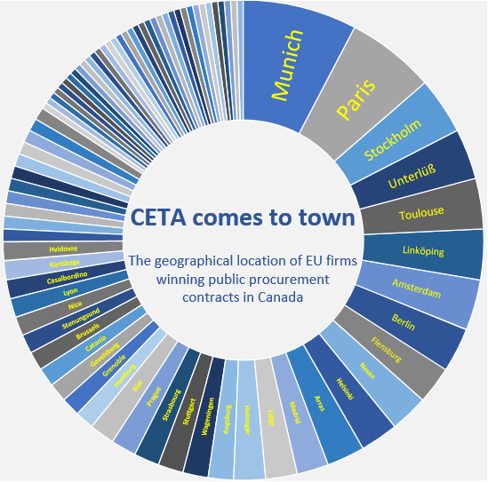
EU-Canada (CETA)
EU-Canada Comprehensive Economic and Trade Agreement (CETA)
A Canadian single point of access and e-procurement platform: CanadaBuys
CandaBuys: the default public procurement system to bid on opportunities conducted by federal procuring entities.
Over 1700 EU suppliers have registered on the new Canadian e-procurement portal
Can be used in combination with Access2Procurement

Slide 6
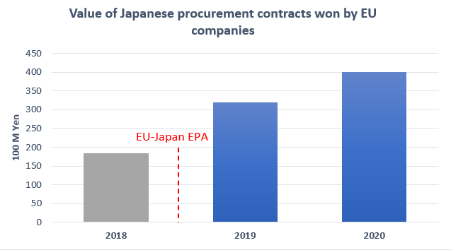
Example: Public procurement in Japan
EU-Japan Economic Partnership Agreement (EPA)
A Japanese single point of access: JETRO
In the Japanese public procurement market, the proportion of international public procurement won by EU companies has increased over time:
24.4% (2003)
40.9% (2010)
41.8% (2020)
The research data cover only Appendix 1 and Appendix 3 entities in Japan which are covered by the WTO/GPA.

Slide 7
Promoting SME participation in international procurement
The vast majority of EU exporters are SMEs, and they have a non-negligible part in EU exports
Success in EU public procurement is not limited to large companies: SMEs usually win around 20 % of tenders in Europe
But participation in international procurement is more difficult
The bulk of international procurement is via Mode 2 (local subsidiaries). SMEs don’t usually have subsidiaries abroad
Mode 1 (cross-border) and Mode 3 (suppliers) are good opportunities. Unfortunately, procurement restrictions on both mode 1 and 3 are very frequent
Digital tools are key for the “easification” of international procurement and increase SME participation:
Single Point of Access and e-procurement
Access2Procurement
Access2Conformity

Slide 8
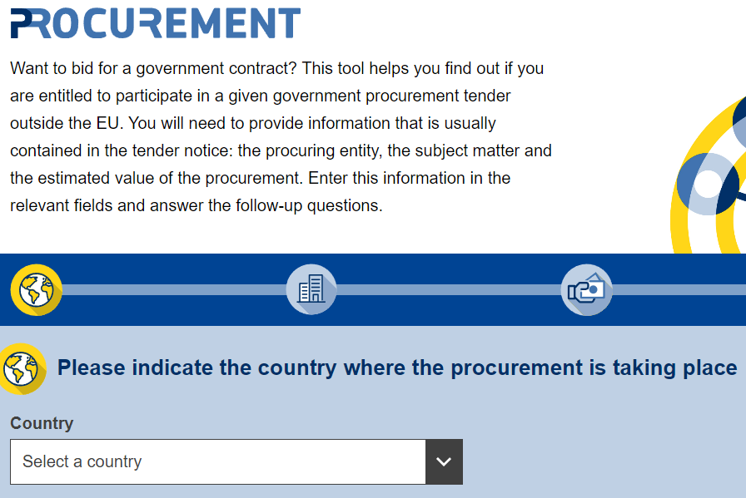
Access2Procurement (A2P)
The tool helps to find out whether a company is entitled to participate in a given public procurement tender outside the EU under the GPA and/or FTA
Currently covers Canada, Japan and USA
The company needs to provide information that is usually contained in the tender notice:
name of procuring entity
subject matter
estimated value of the procurement
answer any follow-up questions
The Access2Procurement tool gives a straight (yes/no) answer for the legal possibility to bid or non

Slide 9
Access2Conformity (A2C): staying competitive in procurement procedures
Winning in public procurement tenders might require compliance with local technical standards and product certification
The Access2Conformity tool helps EU exporters check if they can do these procedures in the EU, thanks to Mutual Recognition Agreements (e.g. Australia, Canada, Japan, New Zealand, the US and Switzerland)
Example: EU bidder in Canada for telecom equipment that require safety/inter-operability certification. Access2Conformity indicates whether such testing can be done in Europe.
Access2Conformity saves costs and delays involved in unnecessary double testing and certification.
The EU bid becomes cheaper and more competitive

Slide 10
Thank you

